Slide 1
ATM Machine Simulation

Slide 2
Submitted by: Ibrahim Kholilulla
Id:213061001
Department : CSIT
Batch: 28th
Semester :5th
Course name: project 1
Course code: ict-2302

Slide 3
Submitted to: Mr. Mehedi Hasan
Lecturer of SMUCT
Department :CSE & CSIT

Slide 4
WHAT IS A ATM MACHINE ?
ATM MATCHINE IS A alternative of a cash counter .
Can get money anytime.
From anywhere can get cash by the machine .

Slide 5
About the project
This project made by c programming . It contain with
Balance check
Balance withdraw
Cash deposit
Password change

Slide 6
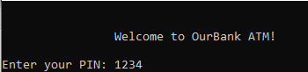
Enter password : 1234
printf("\nEnter your PIN: ");
accountInfo = fopen("Account Balance Information.txt", "r");
scanf("%d", &pin);

Slide 7
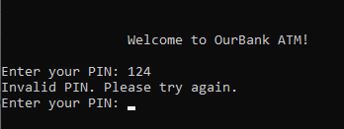
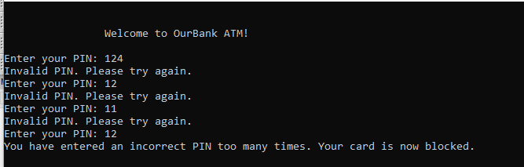
Invalid pin if entered:
while (pin != p && attempt < 2)
{
attempt++;
printf("Invalid PIN. Please try again.\n");
printf("Enter your PIN: ");
scanf("%d", &pin);
}
After enter three time wrong password :
if (attempt == 2 && pin != p)
{
printf("You have entered an incorrect PIN too many times. Your card is now blocked.\n");
return 0;
}

Slide 8
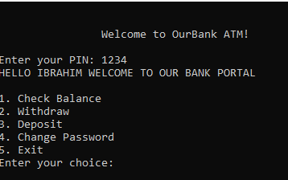
After enter correct password.
printf(“\nEnter your PIN: ");
accountInfo = fopen("Account Balance Information.txt", "r");
scanf("%d", &pin);

Slide 9
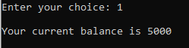
Check balance:1
printf("\n");
printf("Your current balance is %d\n", balance);
accountInfo = fopen(filename, "w");
fprintf(accountInfo, "%d", balance);
fclose(accountInfo);
break;

Slide 10
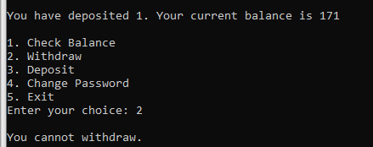
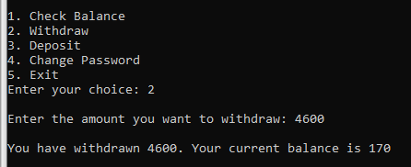
Withdraw:2
If balance bellow 500
if (withdraw > balance)
{
printf("Insufficient balance. Please try again.\n");
break;
}
else
{
balance = (balance - withdraw) - ((5 * withdraw) / 100);
printf("\n");
printf("You have withdrawn %d. Your current balance is %d\n", withdraw, balance);
accountInfo = fopen(filename, "w");
fprintf(accountInfo, "%d", balance);
fclose(accountInfo);
break;
}
}

Slide 11
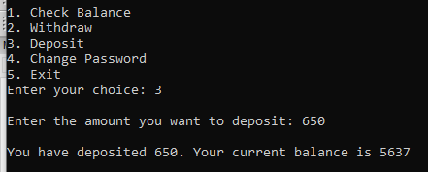
Deposit :3
printf("Enter the amount you want to deposit: ");
scanf("%d", &deposit);
balance = (balance + deposit) - ((2 * deposit) / 100);
printf("\n");
printf("You have deposited %d. Your current balance is %d\n", deposit, balance);
accountInfo = fopen("Account Balance Information.txt", "w");
fprintf(accountInfo, "balance: %d", balance);
fclose(accountInfo);
break;3

Slide 12
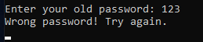
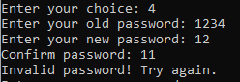
Password don’t match:
If update password don’t match

Slide 13
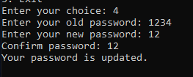
Password change
int p3;
printf("Enter your old password: ");
scanf("%d", &p3);
for (int i = 0; i < 3; i++)
{
if (p3 != p)
{
printf("Wrong password! Try again.\n");
scanf("%d", &p3);
}
else
{
printf("Enter your new password: ");
int p1, p2;
scanf("%d", &p1);
printf("Confirm password: ");
scanf("%d", &p2);
if (p1 == p2)
{
printf("Your password is updated.\n");
accountInfo = fopen("Account Balance Information.txt", "w");
fprintf(accountInfo, "Pin: %d\n", p2);
fclose(accountInfo);
break;
}
else
{
printf("Invalid password! Try again.\n");
}
}
}
break;

Slide 14
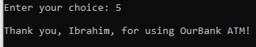
Exit:5
printf("\n");
printf("Thank you, Ibrahim, for using OurBank ATM!\n");
break;

Slide 15
THANK YOU

